Slide 1
Designing the Future
Stewarding Our Community’s Investment & Establishing Our 5-Year Strategic Operating Framework
Planning Framework & Districtwide Conversation Guide
October 12, 2026 Townhall

Slide 2
Building a Sustainable 5-Year Framework
ANCHORING OUR MISSION
PURPOSE & VISION
70-Year Legacy
Celebrating regional excellence while engineering the next generation of institutional impact.
Strategic Purpose
Employer of Choice
Transitioning from past state-apportionment models to a resilient community supported path that guarantees long-term fiscal stability and strategic program alignment for changing student, educational, and regional needs.
Fully resourcing faculty and staff while fostering trust across all bargaining units.
Social Mobility
Removing student barriers to deliver measurable regional economic advancement.

Slide 3


Bay Area is Growing Older – 2025-2050
+29%
The population aged 65+ has grown 29% since 2014.
The population under 18 has declined 15%.
Residents Aged 65+
Falling birth rates and high living costs are creating a "student vacuum" within immediate district borders.
By 2050, more than half of the Bay Area population is expected to be 50+ years old
-15%
Children Under 18

Slide 4
Four Powerful Forces Reshaping Higher Education at the Same Time
Demographic
Economic
Technological
Social

Slide 5
Demographics
Fewer traditional-age students
Aging populations
Changing migration patterns
A more diverse mix of learners, adult learners with different goals, life circumstances and learning formats

Slide 6
Economic
Affordability pressures for students and families
Fiscal constraints for public institutions
Changing funding models
Growing scrutiny of return on investment and economic value

Slide 7
Technological
AI, automation, and intelligent agents
Rapidly changing occupational capabilities
New ways of teaching, learning, working, and creating values
A different relationship between human and machine capability

Slide 8
Social
Declining confidence in institutions
Growing skepticism about whether traditional credentials produce sufficient value
Higher expectations for relevance, transparency, and measurable outcomes
A more informed public with more choices

Slide 9
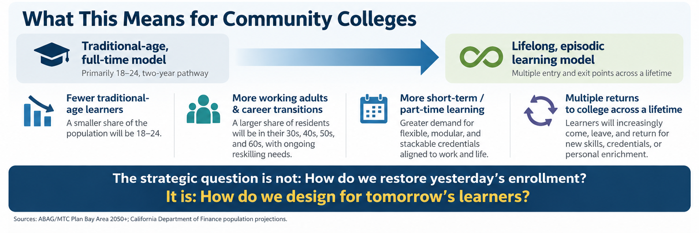
What this means for community colleges

Slide 10
Key operational drivers defining our strategic planning environment
over the next 5 years
OPERATING CONTEXT
Funding Model Pivot
FTES Baseline
Academic Transition Period
Transition to Community-Supported (Basic Aid) status driven by local property tax yields.
Long-term operating baseline stabilized resident FTES.
Cushion established to protect instructional excellence for upcoming two years.
Fiscal Alignments
Strategic Vacancy Review
5-Year Transition Horizon
Requirements to balance budget with compounding annual fixed costs (pensions, health benefits, inflation).
Evaluating open staff vacancies to optimize organizational capability and structure.
Phased multi-year implementation plan to ensure stability and thoughtful execution.
Foothill-De Anza Community College District
Designing the Future — Town Hall 2026

Slide 11


Built for a Different Operating Era
OPERATING ENVIRONMENT
Transitioning from state FTES apportionment caps to local community support.
Past: SCFF Apportionment Model
Future: Community Supported (Basic Aid)
FTES Bound: Revenue tied strictly to resident FTES metrics & state caps.
Local Property Tax Yield: Local taxes exceed state general apportionment limits ($186.7M).
State COLA Dependent: Annual revenue adjustments dictated by state allocations.
Long-Term Growth Potential: Revenue grows with property valuation over time.
Hold-Harmless Buffer: Protected baseline funding during post-pandemic recovery.
Local Stewardship Focus: Operational philosophy shifts from FTES volume to student success.
Foothill-De Anza Community College District
Designing the Future — Town Hall 2026

Slide 12



Our Optimism: Future Opportunities for us to Redesign
INSTITUTIONAL REDESIGN
Academics
Operations
Human Capacity
Facilities
Modernize offerings, program mix, credentials, schedules, modalities, and pathways to align with emerging learning models around changing demographics, learner needs, and regional capabilities.
Process efficiency and modernized technology infrastructure.
Optimized staffing structures and professional growth. Aligning our people, organizational capabilities, roles, and professional learning with the institution we are becoming
Measure G bond deployment, facilities master planning, and housing developments.

Slide 13



Our Shared Interests Across the District
ANCHORING PRINCIPLES
The core values guiding all decisions during this strategic transition.
Mission & Student Success
Protect academic excellence, student success pathways, and comprehensive basic needs support.
Equity & Economic Mobility
Strengthen equitable outcomes for students and increase opportunities for social/economic mobility.
People & Organizational Capability
Remain an employer of choice, support employee well-being, and maintain competitive working conditions.
Fiscal & Institutional Sustainability
Align ongoing recurring expenditures with long-term predictable property tax revenue streams.
Foothill-De Anza Community College District
Designing the Future — Town Hall 2026

Slide 14
Districtwide Governing Conditions
BOUNDARIES & COMPLIANCE
Statutory, legal, and regulatory parameters bounding our strategic choices.
Legal & Regulatory Rules
Governance & Labor
50 Percent Law Compliance: Maintain required direct instruction ratio (50.5% in FY26).
Bargaining Obligations: Honor union contracts and collective bargaining rights.
Faculty Obligation Number (FON): Strictly fulfill full-time faculty staffing mandates.
Participatory Governance: Active engagement through CAC and Academic/Classified Senates.
Financial & Reserves
Revenue Assumptions
Multi-Year Reserves: Target 16.67% stability buffers per state forward guidance.
Property Tax Projections: Model realistic growth assumptions.
Nonresident Volatility: Manage international tuition fluctuations prudently; intentional proportion of ongoing vs. one-time funding.
One-Time vs. Recurring: Never use temporary one-time reserves for ongoing positions.
Foothill-De Anza Community College District
Designing the Future — Town Hall 2026

Slide 15
Year One Planning Milestones (2026–2027)
PROCESS & TIMELINE
AUG–SEPT 2026
OCTOBER 2026
NOV 2026–FEB 2027
MAR–JUNE 2027
Models & Launch
Stakeholder Input
Redesign & Test
Board Adoption
Financial
Communications
Review Data
Explore Options
Analyze Options
Districtwide townhalls
Options development
Data needs assessment
Participatory governance
Shape and integrate ideas
Identify operational efficiencies
Test feedback loops
Revisit with stakeholders
Formulate recommendations
Community engagement
Presentations (external)
Refinements
Recommendations
Board Approval
Implementation

Slide 16
Decision Making and Participatory Governance
GOVERNANCE FRAMEWORK
Clarity on recommendation, consultation, and decision roles.
Decision Area | Recommend | Consult | Decide | Inform
Resource Allocation Model | ELT / Taskforce | Senates | Chancellor / Board | Districtwide
Reserve & Stability Policy | Chief Business Officer | CAC / Advisory Council | Board of Trustees | Campus Leadership
Academic Program Alignments | Academic Senates / Deans | Department Faculty | College Presidents | Board / Public
Strategic Investments | Chancellor's Advisory Council | Participatory Governance | Chancellor / Board | All Stakeholders
Note: Matters within the scope of representation will be addressed through collective bargaining with the exclusive representatives.
Foothill-De Anza Community College District
Designing the Future — Town Hall 2026

Slide 17



Districtwide Communication Cadence
STAKEHOLDER ENGAGEMENT
Internal Governance
Campus Community
External Partners
Input, feedback, updates at ELT, CAC, College Leadership, Academic & Classified Senates, and bargaining leadership.
Districtwide townhalls, division meetings, constituent meetings, and post-Board Chancellor updates.
Consultation with local chambers, rotaries, and regional workforce boards.

Slide 18
Our Shared Commitment
CLOSING THE FEEDBACK LOOP
Here's What We Heard
Here's What We Decided
Here's Why
Here's What's Next
Synthesize input from townhalls and senate conversations.
State executive recommendations and Board authorizations.
Provide full rationale grounded in mission and governing rules.
Outline upcoming milestones, owners, and input channels.

Slide 19
Takeaways
1. Our community is changing—and new opportunities are emerging.
2. We have an opportunity to reimagine our institutional model.
3. Community-supported funding gives us greater freedom to shape our future.

Slide 20
Call to Action
1. Understand where we are.
2. Help us see what we may be missing.
3. Participate in shaping our Five-Year Horizon Plan.
4. Help us move forward together.

Slide 21
Your Questions and Thank you!
Contact Gohar Momjian – momjiangohar@fhda.edu

